Slide 1


Overview of the Year 5 Workplan & Reporting Requirements
October 1, 2019 to September 30, 2020

Slide 2


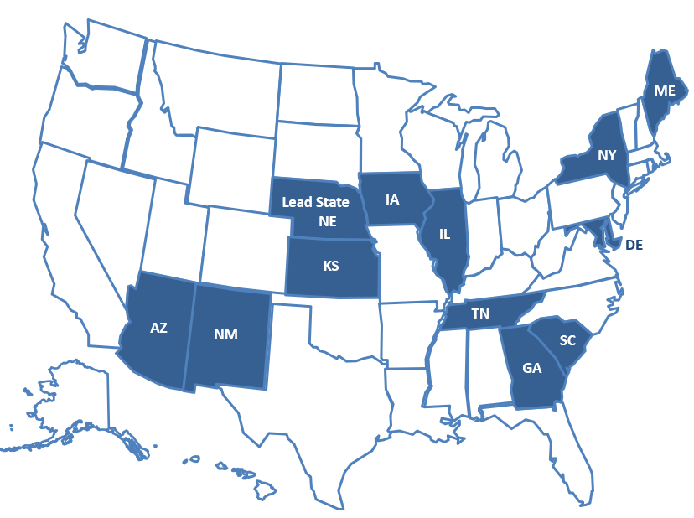


Slide 3

Waiver for Extension
The U.S. Department of Education published a Final Waiver and Extension of the Project Period for Notice of Proposed Requirement on August 14, 2018 proposing a change to the maximum project period of the Migrant Education Program (MEP) Consortium Incentive Grant (CIG) program.
The waiver and extension enables the 34 grantees under the MEP CIG Program that received awards in the fiscal year (FY) 2015 grant competition to continue to receive Federal funding for up to 24 additional months, beginning on October 1, 2018.

Slide 4
Key IRRC Extension Activities
Develop and pilot an electronic ID&R system that features a series of questions to help states determine migrant student eligibility and govern the quality of decision making.
Conduct an assessment of needs to inform capacity in both veteran and new recruiters and administrators.
Develop a 2-tiered, needs-based ID&R professional development plan for states that incorporates successful ID&R strategies and lessons learned.
Disseminate high quality ID&R models, methods, and materials nationally through mentoring, modeling effective practices, materials distribution, and vetted updates to the IRRC website.

Slide 5
Expanded ID&R efficiency, quality, and reliability
ID&R electronic solutions
Professional development in ID&R
ID&R resource coordination/ continuity

Slide 6

Year 5 IRRC Roles
Leadership Team = Sue Henry (Lead State), John Farrell (Lead State Support), Jessica Castañeda (Project Director), Cari Semivan (Evaluator)
State Steering Team (SST) = 12 IRRC State Directors (or their designees)
Technical Support Team (TST) = Representatives of the 12 IRRC States
TST Workgroups = (1) Technology, (2) TRI, (3) Professional Development, (4) Dissemination

Slide 7


IRRC Year 5 Goals, Objectives, and Performance Measures (PMs)
Year 5 Fidelity of Implementation Index (FII)

Slide 8

Goal 1, Objective 1
Goal 1: Improve States’ capacity to make recruitment decisions via technology.
Objective 1: By the end of Year 5, develop an electronic system that helps recruiters efficiently and effectively determine migratory student eligibility.

Slide 9
Goal 1 Performance Measures
PM 1a: By the end of Year 5, a reliable electronic system for eligibility determinations will be developed, field tested, and revised.
PM 1b: By the end of Year 5, 75% of field test recruiters surveyed will report that the electronic system helped them more efficiently and effectively determine migratory child eligibility.
PM 1c: By the end of Year 5, a sustainability plan for the electronic system will be developed, reviewed, and revised.

Slide 10
Goal 1 Key Activities – Year 5
Field test the electronic system in each IRRC State (State Directors/ recruiters)
Revise the electronic system based on field test feedback (Technology Workgroup/ Contractor)
Discuss and finalize the elements of a sustainability plan for the electronic system during TST/SST meetings (TST/SST)
Prepare draft/final short- longer-term sustainability plan (Lead State/IRRC Director/TST/SST)
Convene/participate in 4 TST meetings/webinars (IRRC Director/TST)
Convene/participate in 2 SST meetings (IRRC Director/Evaluator/SST)

Slide 11

Goal 2, Objective 2
Goal 2: Improve MEP staff/recruiters’ capacity to identify and recruit migratory students
Objective 2: By the end of Year 5, 90% of staff participating in IRRC professional development and TRI visits will report that they increased their capacity to conduct/support ID&R.

Slide 12
Goal 2 Performance Measures
PM 2a: By the end of Year 5, 90% of staff participating in IRRC professional development will increase their capacity to conduct ID&R as measured by a statistically-significant gain (p<.05) on a pre/post assessment.
PM 2b: By the end of Year 5, 90% of staff participating in IRRC TRI visits will increase their capacity to conduct ID&R as measured by a statistically-significant gain (p<.05) on a pre/post assessment.

Slide 13
Goal 2 Key Activities – Year 5
Create/administer the updated needs assessment survey to determine staff training needs (PD Workgroup/Evaluator/State Directors)
Identify new and experienced ID&R mentors and coaches from the IRRC States (Leadership Team/State Directors)
Review/revise the 2-tiered (veteran/novice staff) ID&R training model (PD Workgroup)
Conduct ID&R professional development/TRI visits to IRRC States and beyond (TRI Workgroup)
Conduct/participate in 2 regional and/or virtual ID&R PD sessions (IRRC Director/State Directors/TST/MEP Staff)
Conduct/participate in 2 virtual meetings connecting MEP directors with ID&R resources (IRRC Director/State Directors)

Slide 14

Goal 3, Objective 3, PM 3a
Goal 3: Increase States’ capacity to conduct ID&R through the dissemination of high quality ID&R models, methods, and materials through mentoring, modeling effective practices, and vetted updates to the IRRC website.
Objective 3: By the end of Year 5, 90% of IRRC State Directors surveyed will report that IRRC dissemination activities increased their State’s capacity to implement effective and promising practices in ID&R.
PM 3a: By the end of Year 5, 90% of IRRC State Directors surveyed will report that IRRC dissemination activities increased their State’s capacity to conduct effective and efficient ID&R.

Slide 15
Goal 3 Key Activities
Year 5
Maintain and update the IRRC website to increase access to effective and promising practices in ID&R and improve State’s efficiency and effectiveness (Director/Dissemination Workgroup/Leadership Team)
Provide links on the website to successful resources and information for recruiters and their administrators (Director/Dissemination Workgroup/Leadership Team)
Feature newly created product(s) on the website (Director/Dissemination Workgroup)
Disseminate ID&R materials across IRRC States based on recruiter/administrator needs
Disseminate successful ID&R strategies at the ID&R Forum and other MEP-related conferences and meetings

Slide 16

Year 5 TST and SST Meetings
TST Meetings:
1. November 12-13, 2019 in Boston, MA
2. February 26-27, 2020 in San Diego, CA
3. Virtual Meeting (Date TBD)
4. Virtual Meeting (Date TBD)
SST Meetings:
1. October 14, 2019 in Clearwater, FL
2. January 21, 2020 in Charleston, SC

Slide 17


Slide 18

Year 5 Evaluation

Slide 19
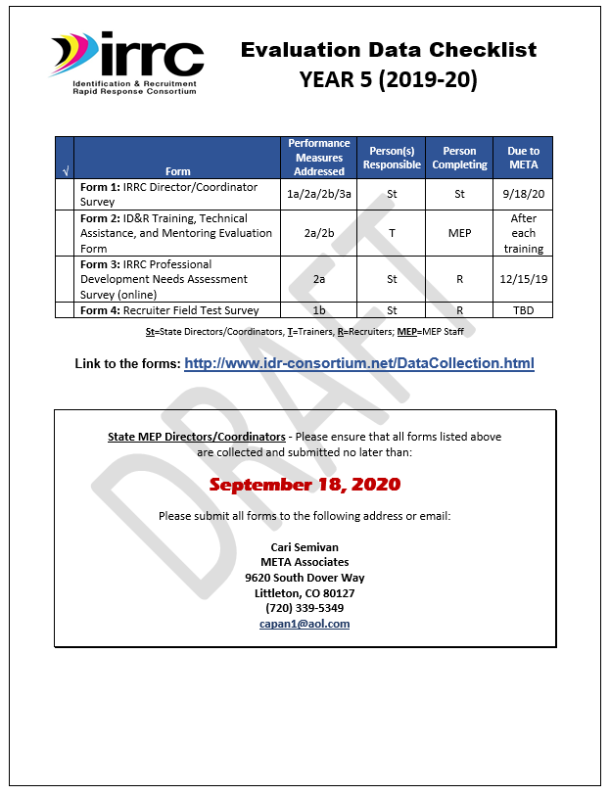

Year 5 State Director Checklist
The State Director Checklist lists everything required of State Directors until next fall, including due dates.

Slide 20
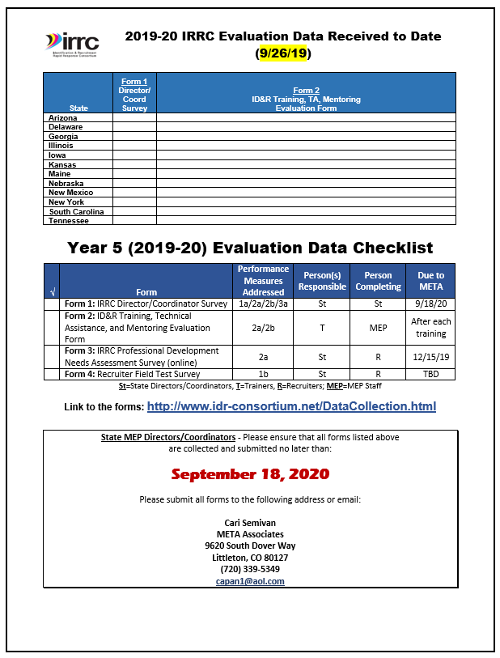
Year 5 Data Checklist
Shows data received to date
Lists all data required for the Year 5 evaluation
Includes persons responsible and timelines
Contains the link to the forms on the IRRC website

Slide 21
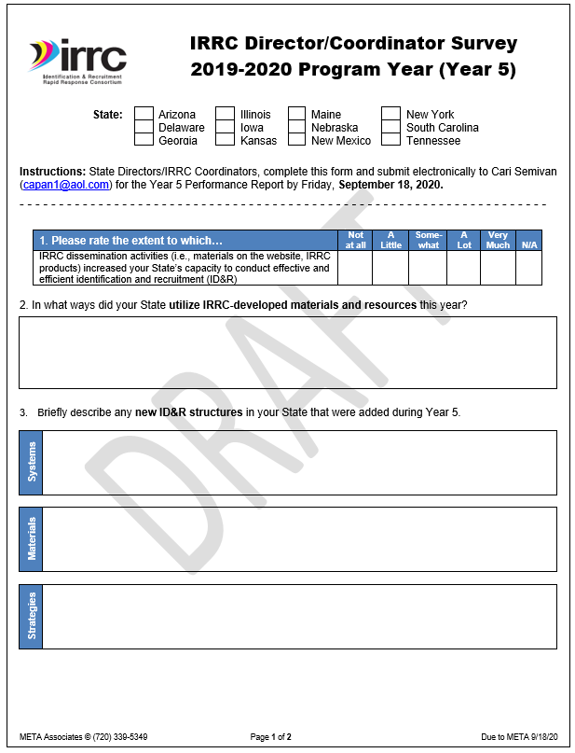
Form 1: IRRC Director/ Coordinator Survey
Contains items needed to respond to the Performance Measures (2 pages)
State Directors: Please submit Form 1’s by 9/18/20

Slide 22
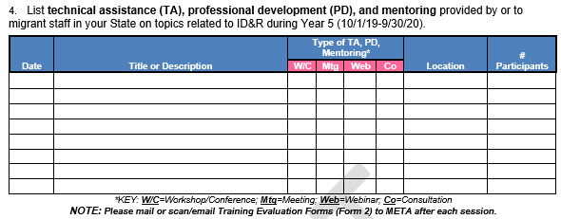
Provide Training in Your State
Submit Form 1 by 9/18/20
Provide technical assistance, PD, and mentoring to MEP staff in your State on topics related to ID&R
Document each training on Form 1: IRRC Director/Coordinator Survey (Item #4)

Slide 23
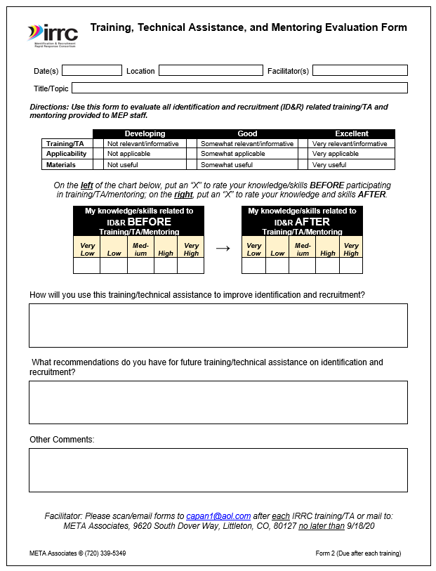
Evaluate Training/TA/ Mentoring
Evaluate each ID&R related training in your State using Form 2: Training, TA, and Mentoring Evaluation Form)
Email to Cari upon completion of each training or by 9/18/20

Slide 24
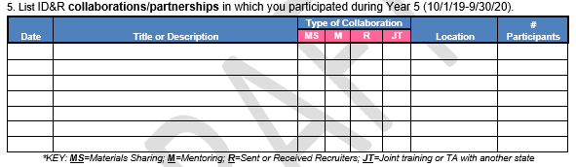
Collaborate
Submit Form 1 by 9/18/20
Collaborate with IRRC/other CIG states through resource sharing, mentoring, sending recruiters to assist/provide TA, and provide joint training
Document collaboration on Form 1: IRRC Director/ Coordinator Survey (Item #5)

Slide 25


Form 3 – IRRC PD Needs Assessment Survey
The Recruiter Needs Assessment Survey will be updated to collect different information from last year
The Survey will once again be online
The due date for completing the Survey will be sometime before the end of the year

Slide 26

Form 4: Recruiter Field Test Survey
The Recruiter Field Test Survey will be completed in collaboration with the Technology Workgroup and the Consultant
Due dates and format will be determined during development

Slide 27

Questions?
Cari Email:
capan1@aol.com
Phone:
(720) 339-5349

